Slide 1


Cyber Safety and Cyber Security

Slide 2
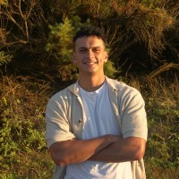
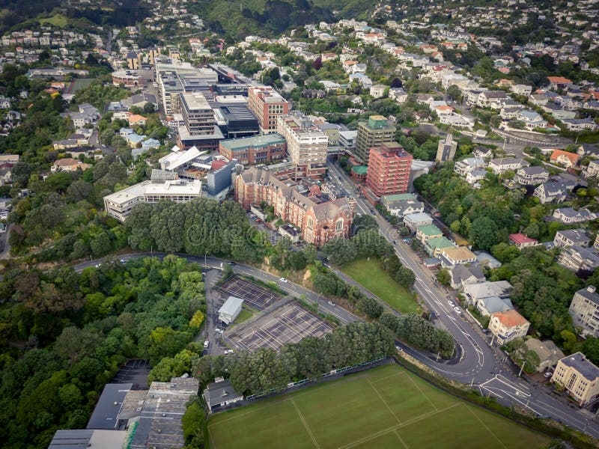

Ko Wai Au?
Ko Whitirea te maunga Ko Porirua te awa Ko Tainui te waka Ko Ngāti Toa te iwi Ko Takapūwāhia te marae Ko Michael rāua ko Raelinda ōku mātua Ko Eden tōku wahine Ko Oreo tōku kurī Ko William ahau

Slide 3
He aha tēnei?
4 Week Course
Intro to Cyber Safety & Cyber Security
Not Graded (Maybe Evaluated)
Password Security, Phishing, Device Security, Cyber Bullying, Digital Footprints, Online Sharing

Slide 4
What is Cyber Safety?
Cyber safety refers to the safe and responsible use of technology, encompassing practices and behaviors that protect individuals and organizations from online risks. - Google AI
Cyber safety refers to the safe and responsible use of the internet, devices, and online platforms to protect yourself and others from harm. It focuses on protecting personal information, avoiding dangerous online behaviour, and understanding how to interact respectfully and securely online. – Chat GPT
Cyber Safety is using technology in a safe way to avoid, detect, or protect myself from digital threats. – Me GPT
Notes:
Examples: Not adding friends you don’t know Not accepting messages from people you don’t know
Not clicking onto certain ads (Temu type – “You have won a prize”)

Slide 5
What is Cyber Security?
Cybersecurity is the practice of protecting computer systems, networks, and data from digital attacks, damage, or unauthorized access. Google AI
Cyber security is the practice of protecting systems, networks, and data from digital attacks. These attacks can come from hackers, malware, viruses, or other threats that try to access, steal, damage, or disrupt sensitive information or operations. – Chat GPT
Cyber Security involves the active protection of systems and their components from threats. – Me GPT

Slide 6
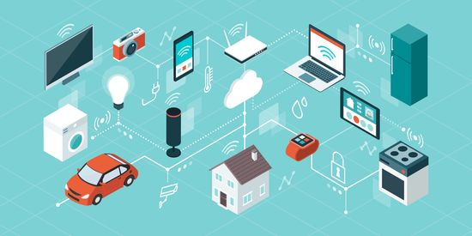
Why Cyber Safety or Cyber Security?
How many devices do you use a day?
How many devices do you see a day?
How much of your info is on those devices? (Photos, Passwords, Accounts, etc)

Slide 7
Lesson Plan: Password Protection and Phishing Awareness
Outcomes:
Understand Password Safety and how to implement safe password habits
Recognise Phishing Attempts and know how to respond
Notes:
AI-generated content may be incorrect. --- This lesson plan focuses on enhancing understanding and skills around password security and phishing awareness. We'll guide participants through recognising weak password habits, creating strong passwords, identifying phishing attempts, and applying safe practices both personally and in their communities.

Slide 8
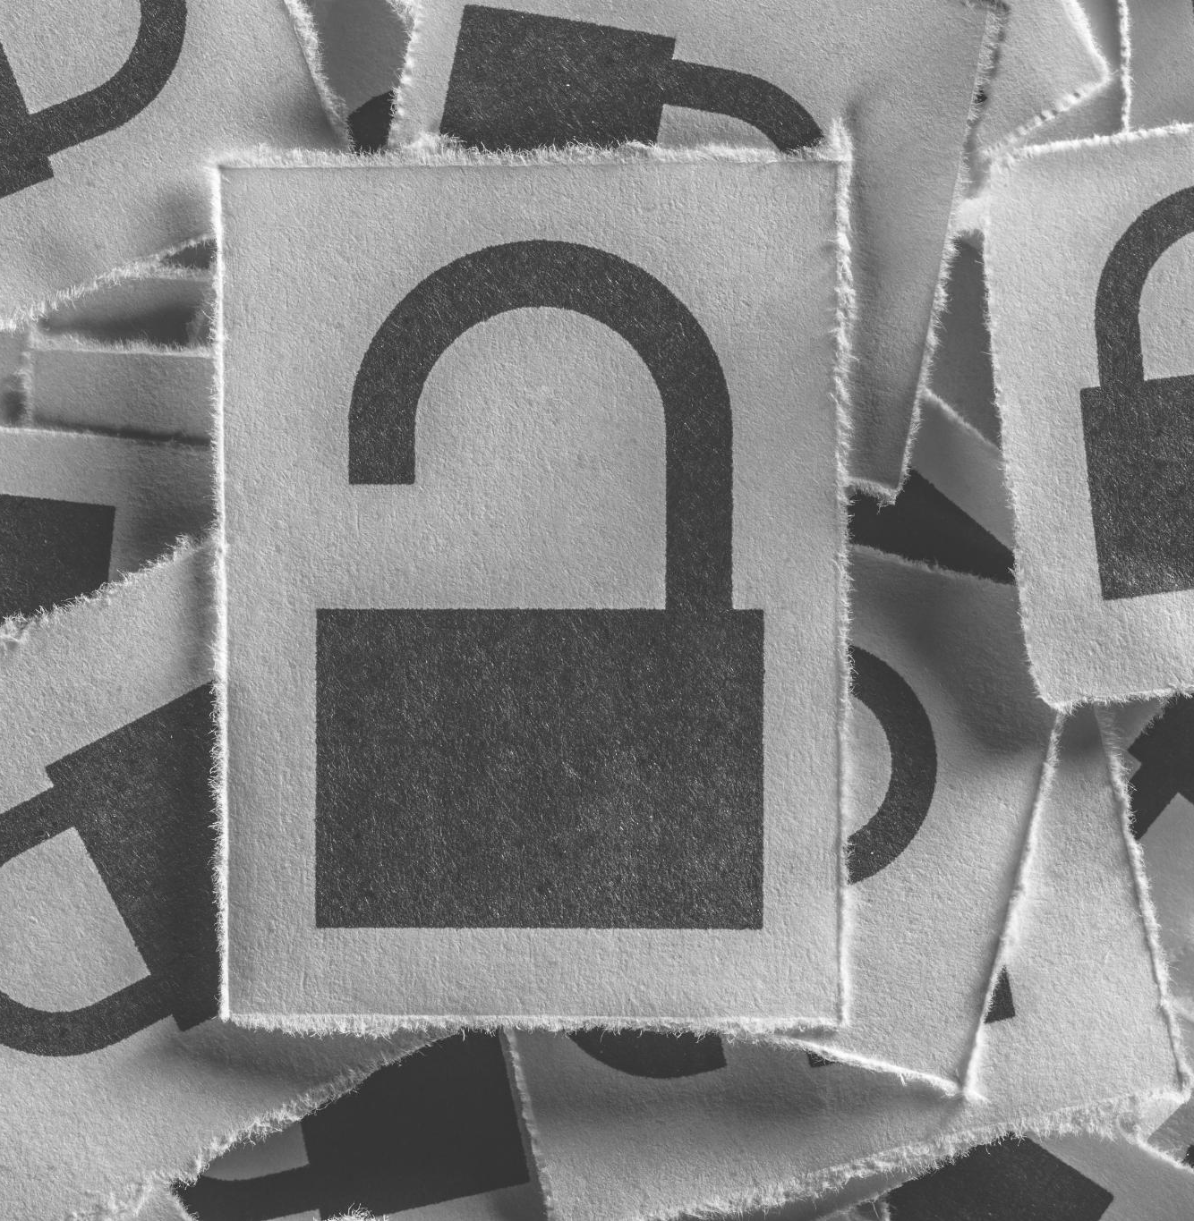
Today's Learning Agenda
Introduction and Icebreaker: Understanding Password Habits
Creating and Managing Secure Passwords
Identifying Phishing Attempts and Safe Practices
Discussion, Reflection, and Take-Home Application
Notes:
--- Our session will begin with an introduction and icebreaker to explore common password habits. Next, we'll dive into creating and managing secure passwords. Following that, we'll focus on identifying phishing attempts through real-life examples and activities. Finally, we'll reflect on lessons learned and discuss take-home applications. Image source: Microsoft 365 content library

Slide 9
Introduction and Icebreaker: Understanding Password Habits
Notes:
We'll start by engaging everyone in sharing their experiences with passwords, particularly the weakest ones they've used. This helps highlight common mistakes and sets the foundation for improving password security awareness throughout the session. If not we will go to have I been Pwned .com

Slide 10
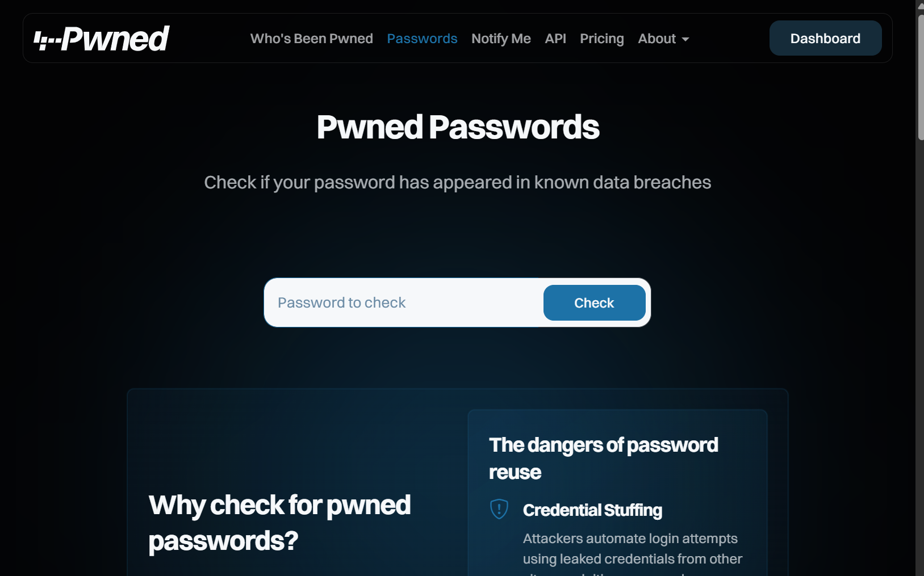
Activity: https://haveibeenpwned.com/Passwords
Notes:
Have I Been Pwned is a free to use website to see where and when your data has been breached (at least - that because it is only noticing the ones made public). Although it doesn’t show us how safe a password is it can help us determine how common one is and the likelihood that it has been used and exposed online. If yours does not show up, chances are its pretty unpredictable. Pwned just means owned or dominated, it’s a slang term that has shifted to meaning breached in cyber security.
This shows whether or not your password has been exposed in a data breach

Slide 11
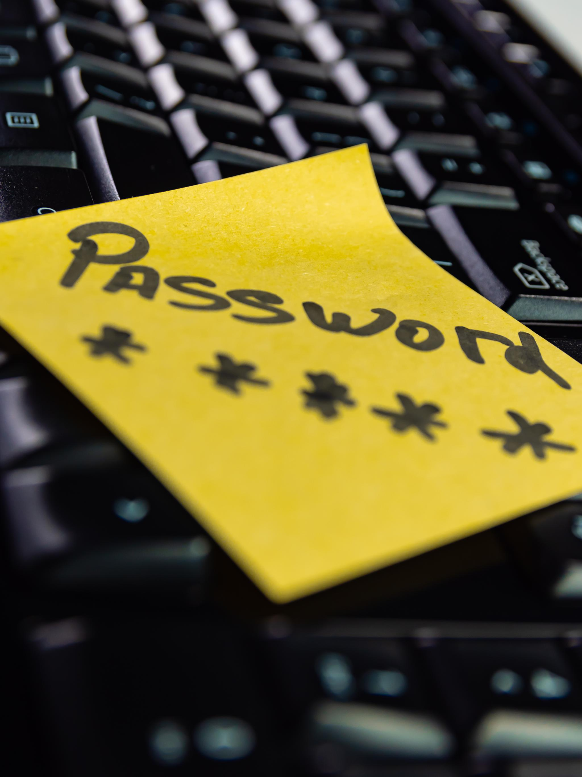
Discussing common password mistakes
Predictable Sequences
Using easily guessable sequences weakens password security and makes accounts vulnerable to attacks.
Personal Information Usage
Including personal details in passwords increases risk of exposure through social engineering or data breaches.
Password Reuse
Reusing passwords across multiple accounts jeopardizes security when one site is compromised.
Password Simplicity
Using passwords that are simple and lack character complexity. (Symbols, Numbers, Capital & Lower Case Letters)
Notes:
--- We will discuss typical mistakes made when creating passwords, such as using predictable sequences, personal information, or reusing passwords across accounts. Image source: Microsoft 365 content library

Slide 12
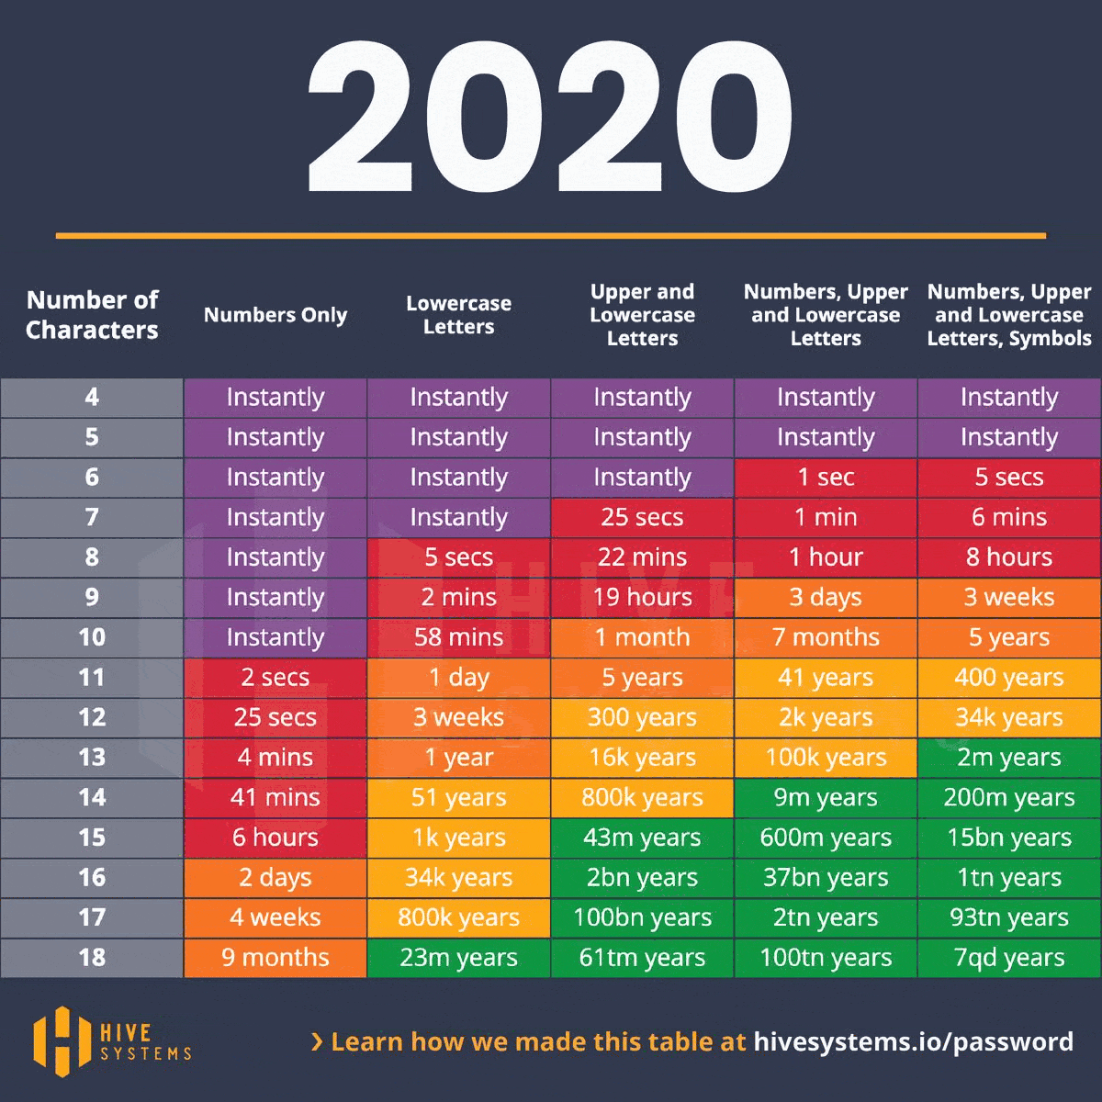
What makes a strong password?
Password Length
Longer passwords provide greater security by increasing the number of possible combinations.
Password Complexity
Strong passwords combine uppercase, lowercase letters, numbers, and special characters.
Avoid Common Patterns
Avoid using predictable words, sequences, or patterns that hackers can easily guess.
Unpredictability
Unpredictable passwords reduce the risk of being cracked by random guessing or brute force.
Notes:
--- We cover essential elements like length, complexity, unpredictability, and avoiding common words or patterns to build strong passwords. Image source: Microsoft 365 content library

Slide 13
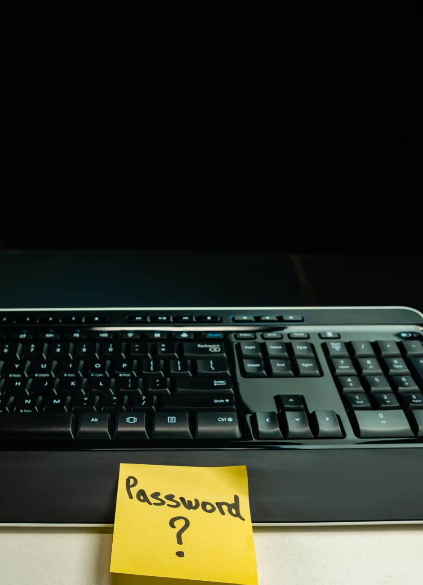
Demonstration: How quickly weak passwords can be cracked
Rapid Password Cracking
Simple and common passwords can be cracked within seconds by modern hacking tools.
Weak Password Risks
Using weak passwords significantly increases vulnerability to unauthorized access and cyber attacks.
Importance of Strong Passwords
Choosing complex passwords is essential to protect personal and sensitive information effectively.
Notes:
--- A live or video demonstration will show how fast simple or common passwords can be guessed or cracked using hacking tools, highlighting the need for stronger choices. Image source: Microsoft 365 content library

Slide 14
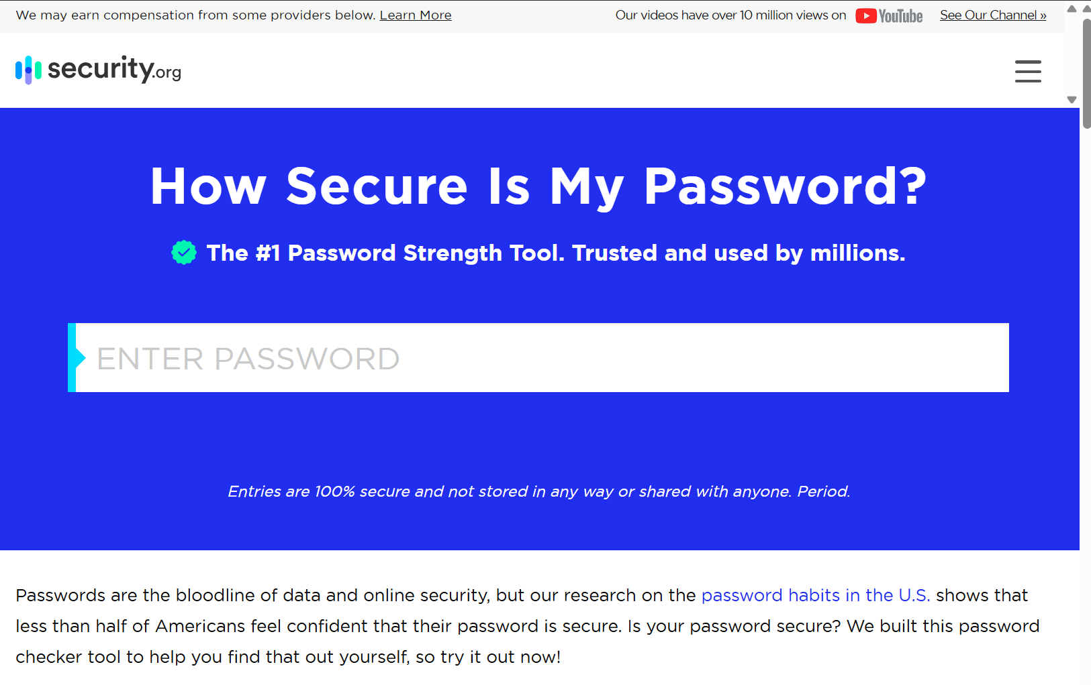
Activity: https://www.security.org/how-secure-is-my-password/

Slide 15
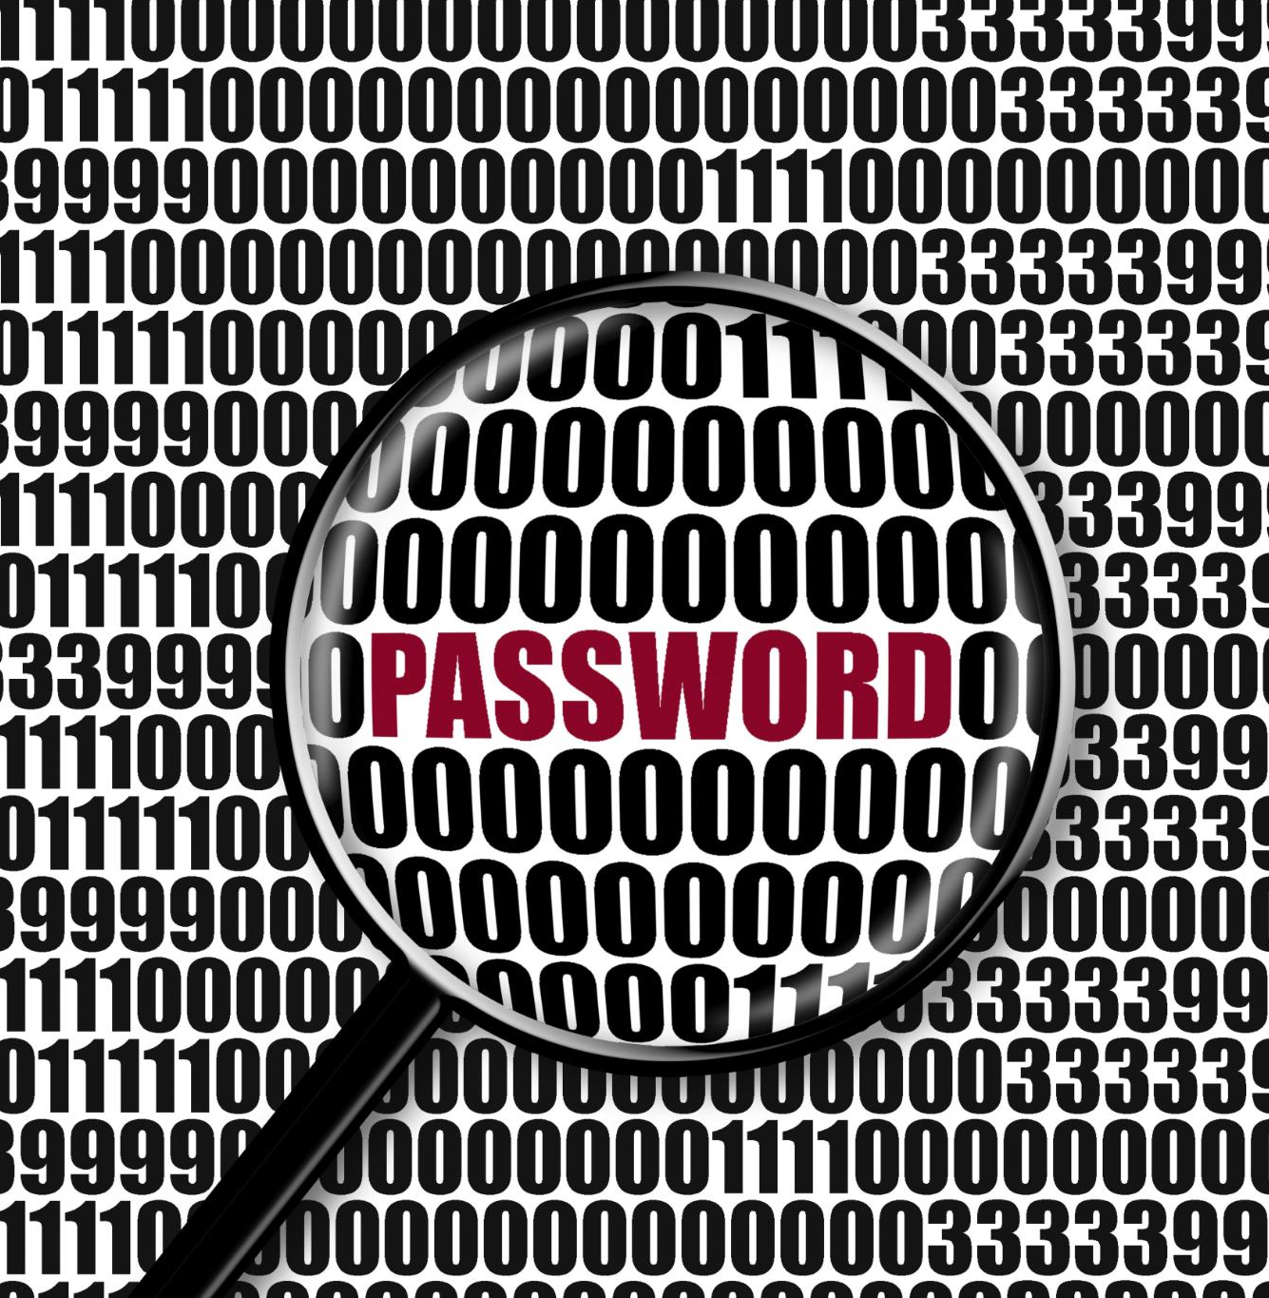
Assignment: Building a strong passphrase using words, numbers, and symbols
Creating Strong Passphrases
Combine unrelated words with numbers and symbols to build a memorable yet secure passphrase.
Change Passwords
Although not covered in depth today, changing your password regularly is another way to maintain a secure account.
Notes:
--- Participants will practice creating strong passphrases by combining unrelated words with numbers and symbols, making passwords easier to remember yet secure. Image source: Microsoft 365 content library

Slide 16
Identifying Phishing Attempts and Safe Practices
Notes:
This section helps participants recognise phishing messages and suspicious links, equipping them with skills to avoid falling victim to scams.

Slide 17
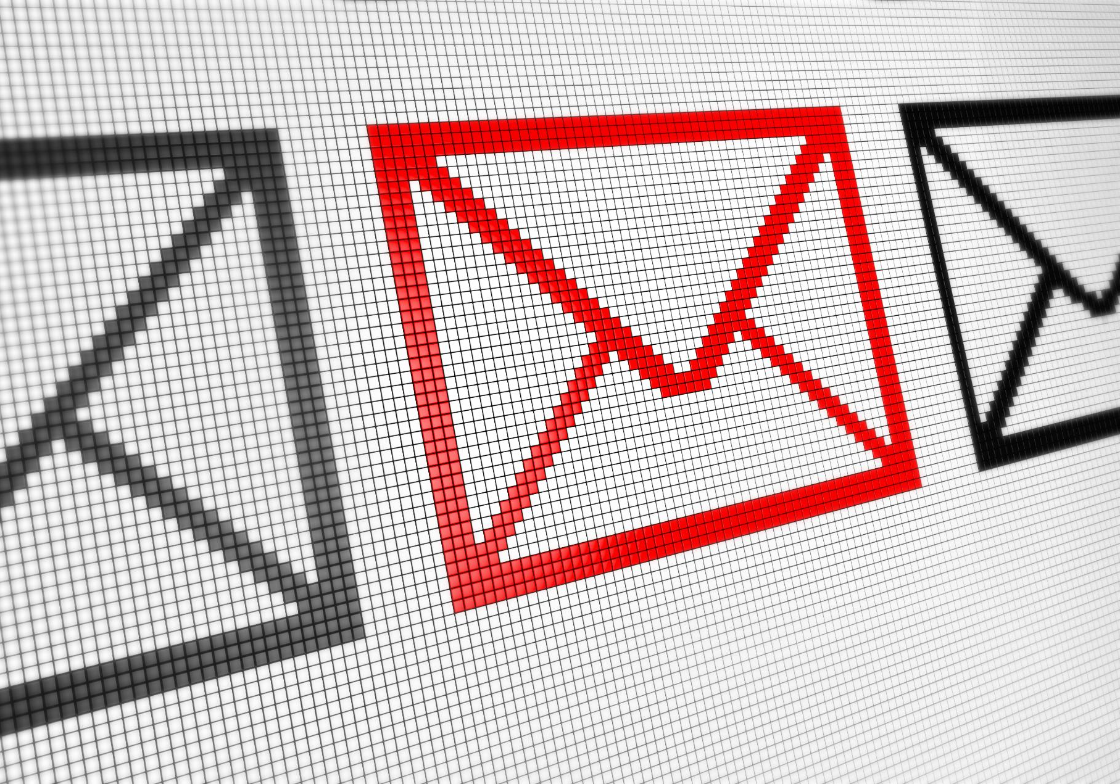
Recognising phishing messages and suspicious links
Urgent Requests
Phishing messages often create a false sense of urgency to prompt quick actions without thinking.
Misspellings and Errors
Common signs include spelling mistakes and grammatical errors indicating a suspicious message.
Suspicious Sender Addresses
Phishing emails often come from unfamiliar or deceptive sender addresses to trick recipients.
Misleading URLs
Links in phishing messages may look legitimate but redirect to fraudulent websites.
Notes:
--- We outline common signs of phishing such as urgent requests, misspellings, suspicious sender addresses, and misleading URLs. Image source: Microsoft 365 content library

Slide 18
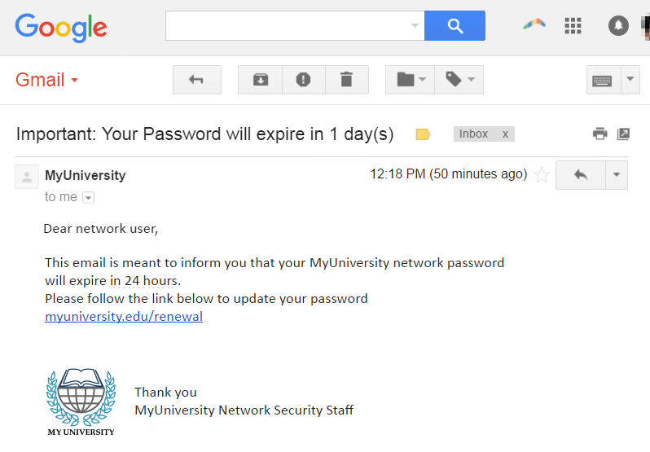
Example:

Slide 19
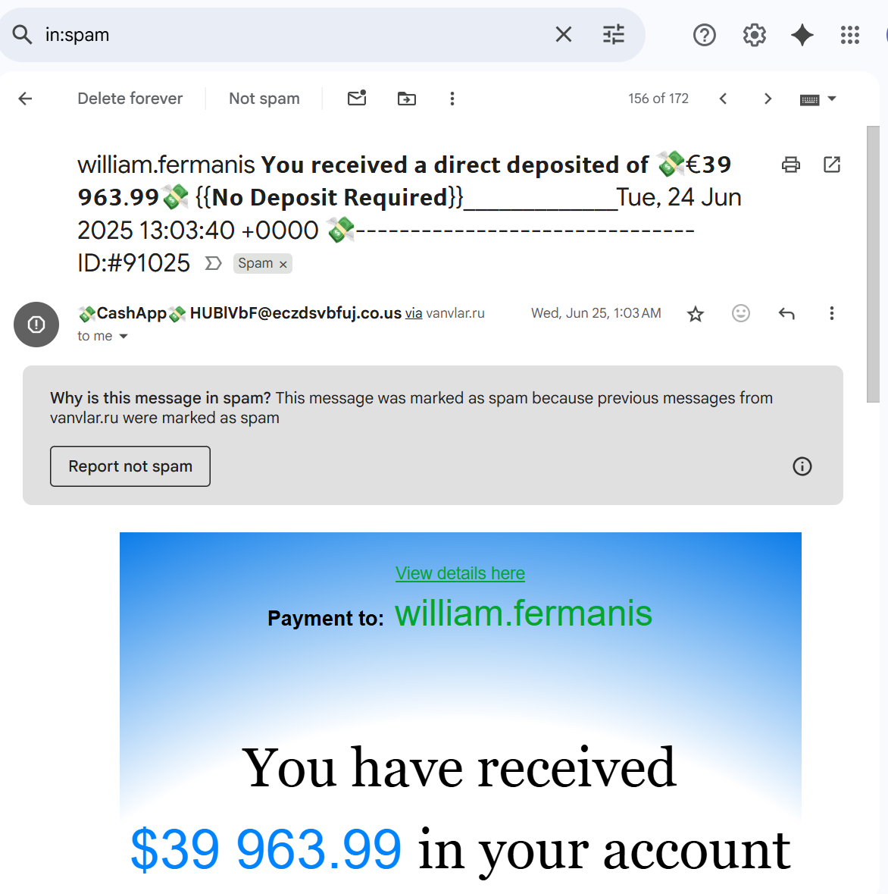
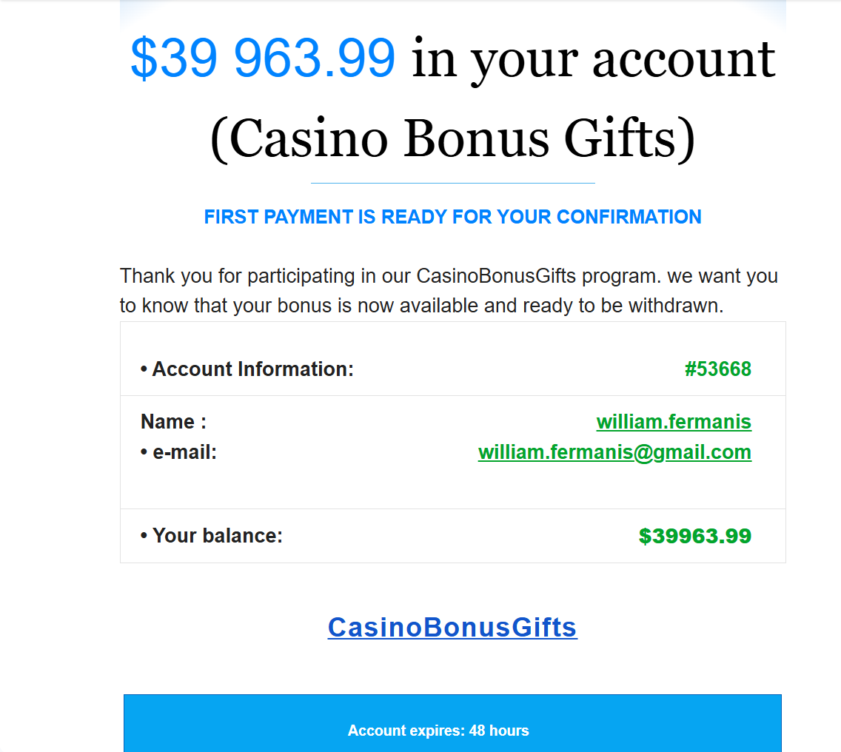
Example:

Slide 20
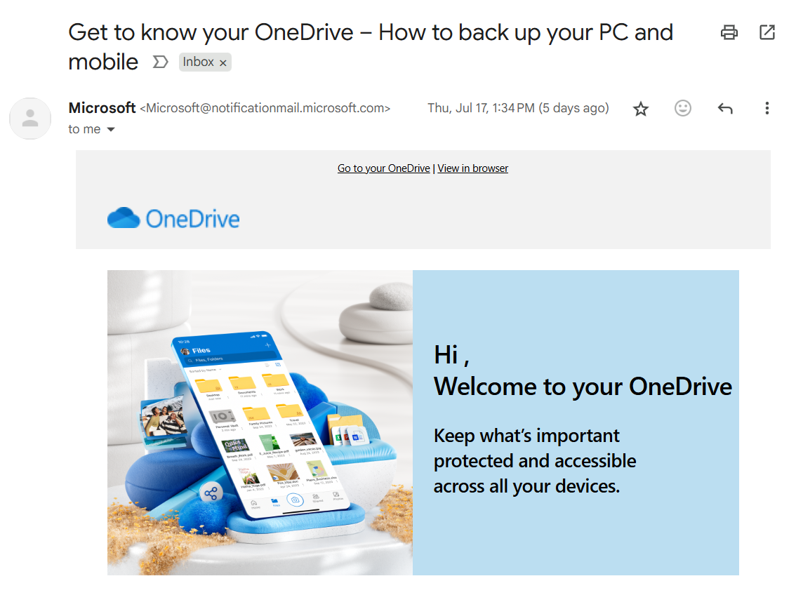
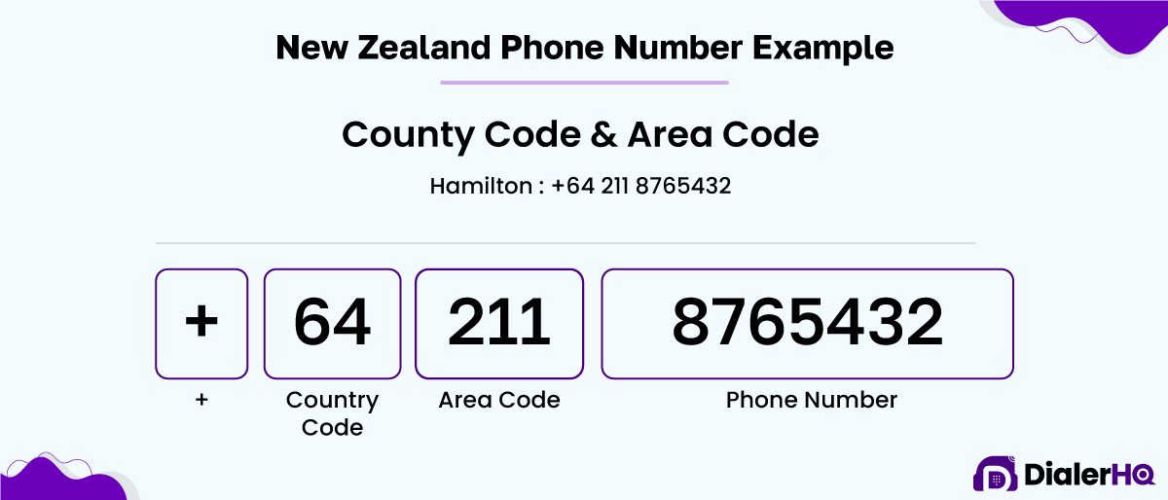
Examples: Fake vs. real emails and texts
Authentic Communication Features
Real emails and texts typically have correct sender information and personalised content.
Phishing Attempt Indicators
Fake messages often contain suspicious links, poor grammar, and urgent requests.
Real Email Addresses/numbers
Email addresses/numbers are correct and follow conventional format, ie. security@account.meta.com vs security@account.mita.com
Notes:
--- Participants examine real-life examples contrasting authentic communications with phishing attempts to identify key differences. Image source: Microsoft 365 content library

Slide 21
Assignment: Create your own phishing email and send it to a parent/teacher
Small details
Focus on the small details that you would notice are suspicious when reading or viewing an email if missing.
Context
What type of email do you expect your target to respond to or consider in the first place.
Notes:
--- Participants will practice creating strong passphrases by combining unrelated words with numbers and symbols, making passwords easier to remember yet secure. Image source: Microsoft 365 content library

Slide 22
Discussion, Reflection, and Take-Home Application
Notes:
We conclude by reflecting on why phishing is effective, sharing personal takeaways, and setting actionable tasks to reinforce safe practices beyond the classroom.

Slide 23
Questions?
What we learned?
What I’m Studying?
Where to start if I want to continue studying?
Anything to do with Software Engineering or Cyber Security?

Slide 24

Homework:
Password Assignment: Building a strong passphrase using words, numbers, and symbols and testing it on both Websites.
Phishing Assignment: Create your own phishing email and send it to a parent/teacher
Notes:
--- A group discussion on psychological tricks used in phishing and strategies to educate and protect friends and family. Image source: Microsoft 365 content library

Slide 25
Extra Time:
Go to Interland and play either:
Don’t Fall for the Fake
Tower of Treasure
https://beinternetawesome.withgoogle.com/en_us/interland
Do your Assignments for the day
Go to Github/William-Fermanis
Go To Cyber Safety Course Repository
Download and Play Password Security Game using Python
Extra: This is a bit extra to set up so maybe try the first two and do this at home if you are interested in coding and password guessing (I can provide a demo if you are interested)
Notes:
--- To consolidate learning, participants will create a new secure password for an account and share phishing awareness with someone close to them. Image source: Microsoft 365 content library

